Slide 1
ArchiMate®
Application Layer

Slide 2

APPLICATION
Language
Notation
Deliverables
Who are you?
What’s wrong?
How do we fix it?
Notes:
APPLICATION LAYER – p35

Slide 3
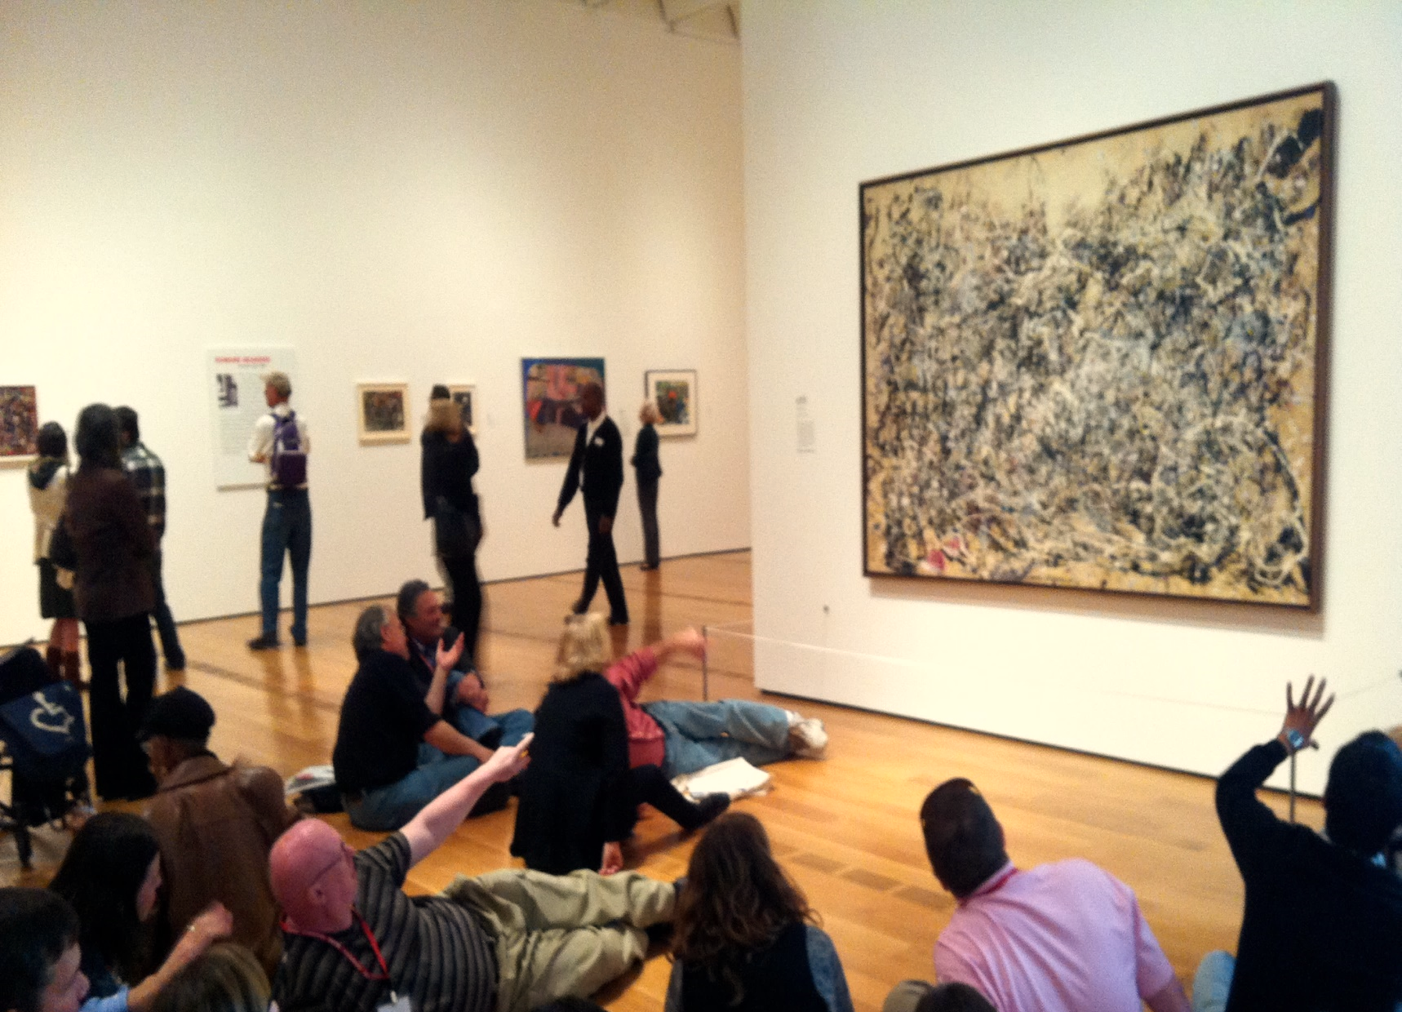
What is this computer system built from?
What kinds of things can it do?
Who would end up using it?
Does it work with other systems?
FORM
AUDIENCE
MESSAGE

Slide 4
Application Viewpoints
Application Behaviour
Application Co-operation
Application Structure
Notes:
WHICH ONES do we do now?
AUDIENCES?

Slide 5



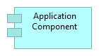
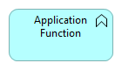
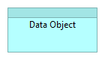
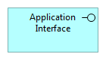
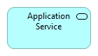
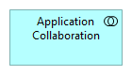
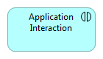
ACTIVE
BEHAVIOUR
PASSIVE
PERFORMS
ON
OFFERS
PERFORMS
ON
Notes:
REFER to REFERENCE CARD

Slide 6

I can install it
I could swap it out
I might turn it on or off
It could be a plug-in
It could provide interfaces
I could re-use it

Slide 7
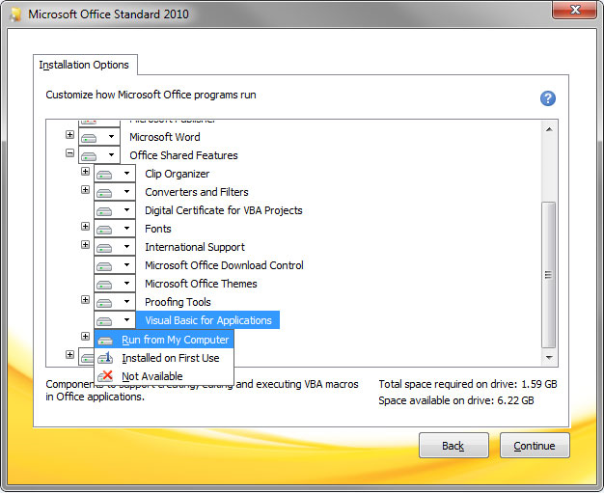
Notes:
Do I install Proofing Tools or not? Do I install French Dictionaries or not?
OTHER EXAMPLES of components?

Slide 8
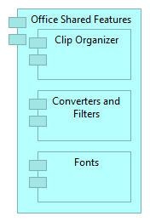
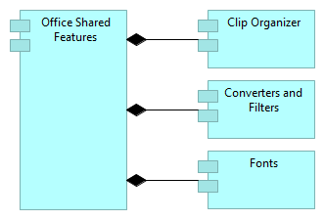
PART OF
Notes:
So here’s an Archimate diagram showing that screen.
This is COMPOSITION – Clip Organizer IS PART OF Office Shared Features
BOTH VERSIONS ARE VALID
Are they MODULAR, DEPLOYABLE, REPLACABLE?

Slide 9
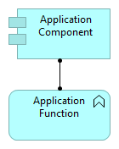
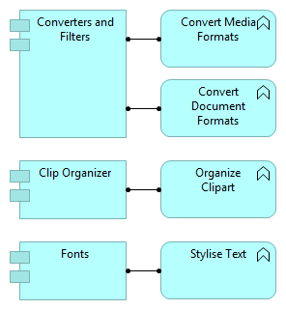
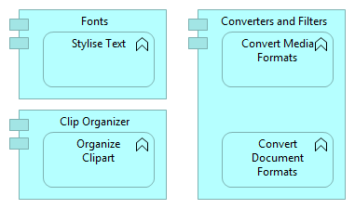
Notes:
ROLE PROFILE for the application – the Job Description
DEFINITION: COMPONENT is ASSIGNED to perform a FUNCTION – in Archi, if you hover over a relationship it actually SAYS the sentence for you!
DISTANCE from HOW IT’S ACTUALLY DONE = we speak ENGLISH NOW!
Both these ways of drawing the thing are valid.
Me vs my job
Software vs its job

Slide 10
Pick a computer system List its Components Write its Functions (its JD!) Give it structure Draw an Application Behaviour Viewpoint We’ll interpret it together!

Slide 11

A SERVICE is defined as a unit of functionality that a system EXPOSES to its environment, while hiding internal operations, which provides VALUE (monetary or otherwise)
Notes:
P3 “SERVICE ORIENTATION” – part of the Core Concepts
SLOW DOWN!

Slide 12
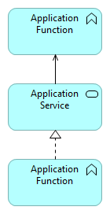
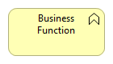
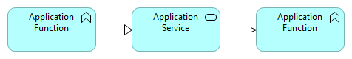
MY ABILITIES
OFFERINGS
YOUR ABILITIES
Notes:
System ABILITY (what it can do) is not the same as USE
My ABILITIES are not the same as my USE!!
Services are REALISED by functions and then USED by other functions.
Think of it like this: our CHEF can perform COOKING – but how do I actually USE that ability? What are the contracts in place, the standards for placing an order. Where is his ORDERING SERVICE?
You can therefore introduce APPLICATION SERVICES to SPECIFICALLY describe how things being DONE in one place can be accessed by something else doing OTHER things in another place.

Slide 13
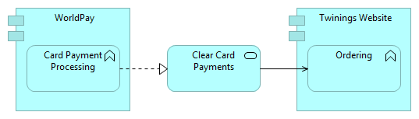
Notes:
NESTING is for ASSIGNMENT as well!
Question : Interpret?
Answer : The Worldpay Component is assigned to perform Card Payment Processing. That offers a service to Clear Card Payments. Meanwhile, the Twinings Website is assigned to perform the Ordering function, and as part of that it uses the Card Payment Processing service.
SO far we’ve only looked at the BEHAVIOUR. How does this actually get REALISED?

Slide 14
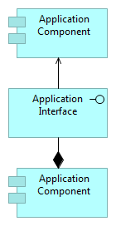
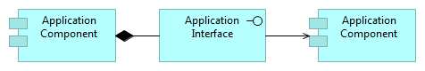
MY RESOURCES
CONTRACTS
YOUR RESOURCES
Notes:
Let’s flip it on its head. Now we’ll look at the view from the ACTIVE components – the things doing the work.
Here are MY RESOURCES on the left – our Components. And then other Components on the right.
Now, I say to you, if you want to use them, use THIS INTERFACE under THIS CONTRACT.
Notice the “PART OF” relationship between the component and the Interface. This is OPTIONAL and NOT USUALLY SHOWN – but it can be really helpful if there are APIs, for example. See the definition in the Archimate documentation.
OK we’ve seen the BEHAVIOUR – and we know what ACTIVELY does the work
Let’s glue it together!

Slide 15
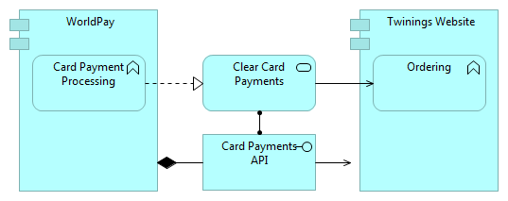
Notes:
On the left – Worldpay is the ACTIVE component is assigned to deliver CARD PAYMENT PROCESSING functionality
On the right – the Twinings Website is assigned to perform ORDERING functionality
In between is the Clear Card Payments service, realised by Card Payment Processing. It’s used by the Ordering feature.
And what actually does the work and defines how to Process Card Payments? It’s the Card Payments API. That’s PART OF Worldpay, and it’s USED BY the Twinings Website.
Think about the AUDIENCE. There are some people who only want to know the FUNCTIONS and SERVICES.
Others will want to know the COMPONENT and the INTERFACE.
Some – like an Architect – may want to know BOTH.

Slide 16
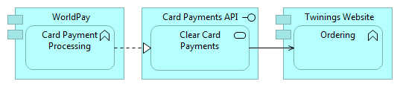
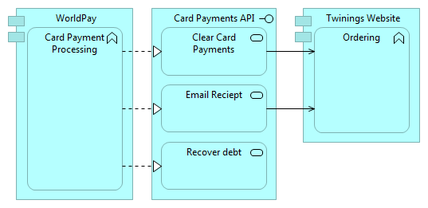
Notes:
Let’s switch it up a bit!! Remember that the “ASSIGNMENT” relationship can be shown nested – and here it is. Nice and neat! We even have spare space on the canvas for more services ASSIGNED to be offered by that API.

Slide 17
Group 1 List some interfaces and their components Which components use those interfaces? Group 2 List some services offered by functions Which functions use those services?

Slide 18

DISTINGUISH BETWEEN behaviour that is performed by a SINGLE structure element or COLLECTIVE behaviour that is performed by a collaboration
Notes:
P4 “COLLABORATION AND INTERACTION” rule

Slide 19
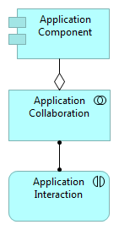
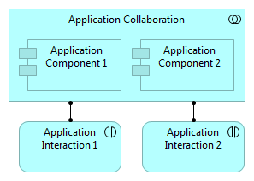
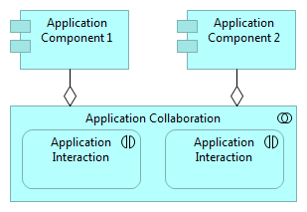
Notes:
COLLABORATION says – these components work together (TEMPORARILY)
INTERACTION says – this is the BEHAVIOUR that they’re going to perform
UML INTERACTION DIAGRAM ⬅ INTERACTION
BOTH VALID – your preference which

Slide 20
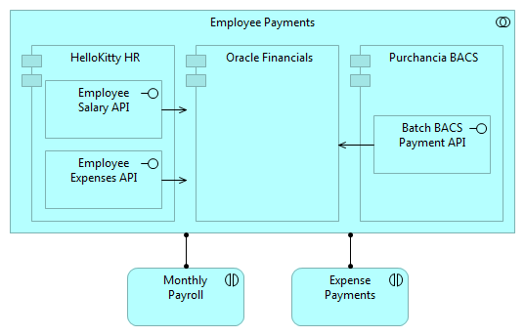
Notes:
VOLUNTEER : interpret

Slide 21
Agree on one collaboration in a system you know well Roughly draw the collaboration List the components Which components use which components? Add the interfaces that those components use

Slide 22

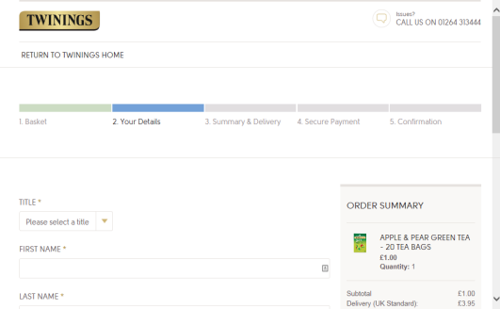
Notes:
Remember this? Which are BEHAVIOURAL? – which are ACTIVE?

Slide 23
Pick a Viewpoint: Structure, Behaviour, or Co-operation Agree on a system to model List the relevant elements Put the Elements into Archi Draw your Viewpoint! After lunch we’ll interpret them!
Notes:
Pick ONE OF THESE

